Slide 1
Correlation Between TCB & TSB in Neonates a Day Old.
Matthew Moreno
SID# 861208517.

Slide 2
Table of Contents
1. Introduction
5. Data Visualization
9. Model 2: TSB ~ TCB
2. Motivation
10. Model 3: log (TSB) ~ TCB
6. Correlation
3. Problems to Solve
7. Linear Model Plot : TSB ~ TCB + Gender
11. Cross Validation
4. Data Collection
8. Model 1: TSB ~ TCB + Birth Wt + Gender
12. Conclusion

Slide 3
Introduction
After being born many babies develop Jaundice, a yellowing of skin color, due to a build up of the chemical called bilirubin. During pregnancy, the mother’s liver removes bilirubin for the baby, but after birth the baby’s liver must remove the bilirubin. In some babies, the liver might not be developed enough to efficiently get rid of bilirubin. If Jaundice is not detected or not treated it may cause a condition called kernicterus. Kernicterus is a type of brain damage that can result from high levels of bilirubin in a baby’s blood.

Slide 4
Motivation
Traditionally bilirubin levels are measured by Total Serum Bilirubin (TSB) via periodic blood samples taken using the heel stick method which can which is painful for the newborn and stressful for some parents. In addition, this method of testing and retesting is a time consuming process, which can delay patient care and cause undue stress to new patients. However a less intrusive and cost effective method is to use a handheld device that measures Trans-Cutaneous Bilirubin (TCB). From previous studies TCB has been shown to be a reliable alternative to TSB and a consistent method to identify newborns that are at risk of having jaundice.

Slide 5
Problems to Solve
1
Is TCB correlated to TSB, If so is TCB measurement an acceptable method for detecting hyperbilirubinemia.
2
Is TSB & TCB correlated to birth weight or gender.

Slide 6
Data Collection
The data consist of 126 neonates born at Riverside County Regional Medical Center between January 1st and June 30th 2014.
Both TSB & TCB measurements were taken after 24 hours of birth.

Slide 7
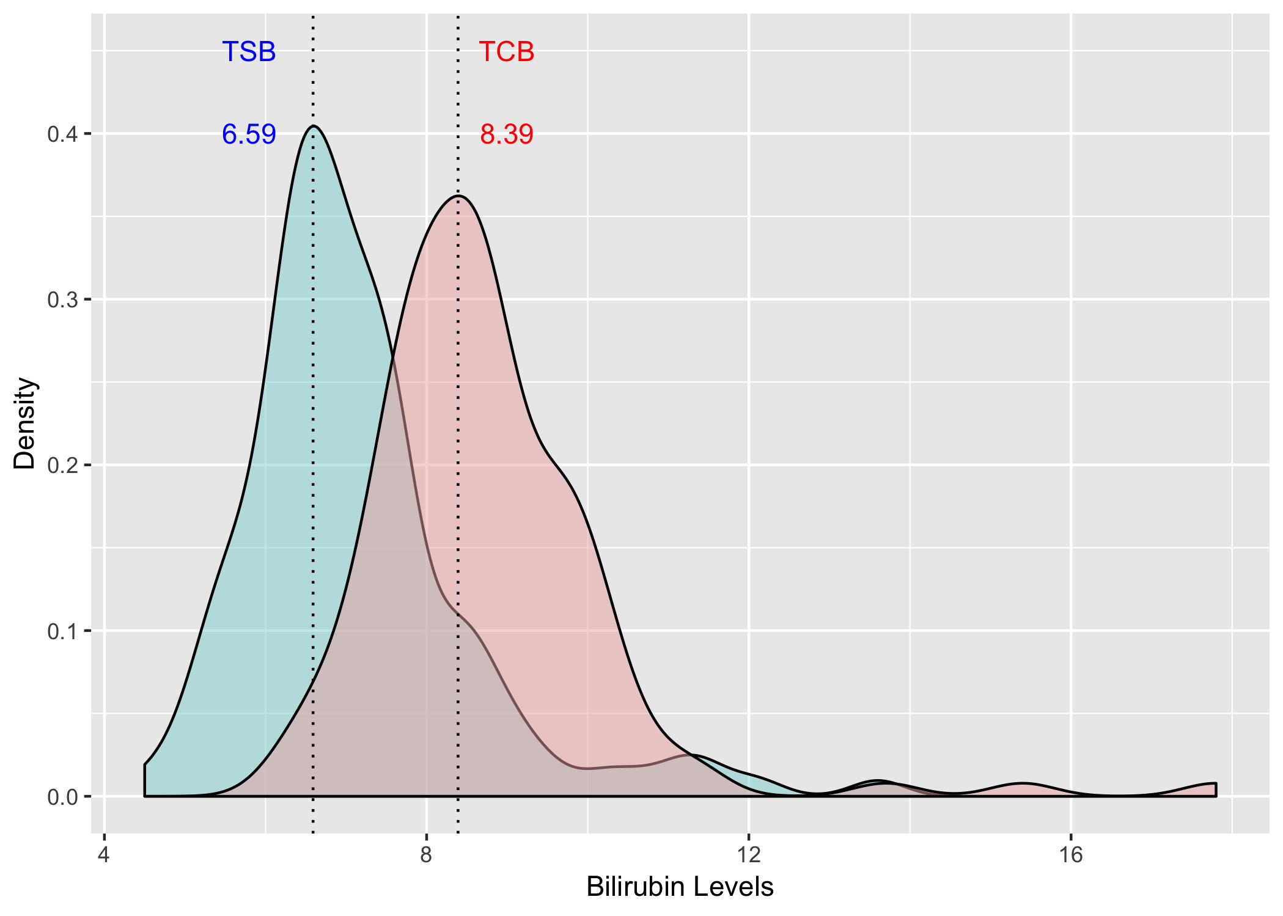
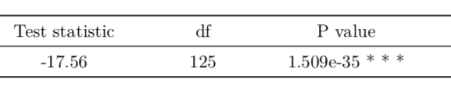
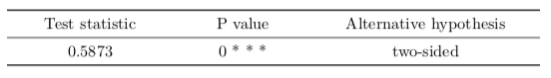
Visualizing TSB & TCB
Two Sample Paired T - Test
Kolmogorov Smirnov Test

Slide 8
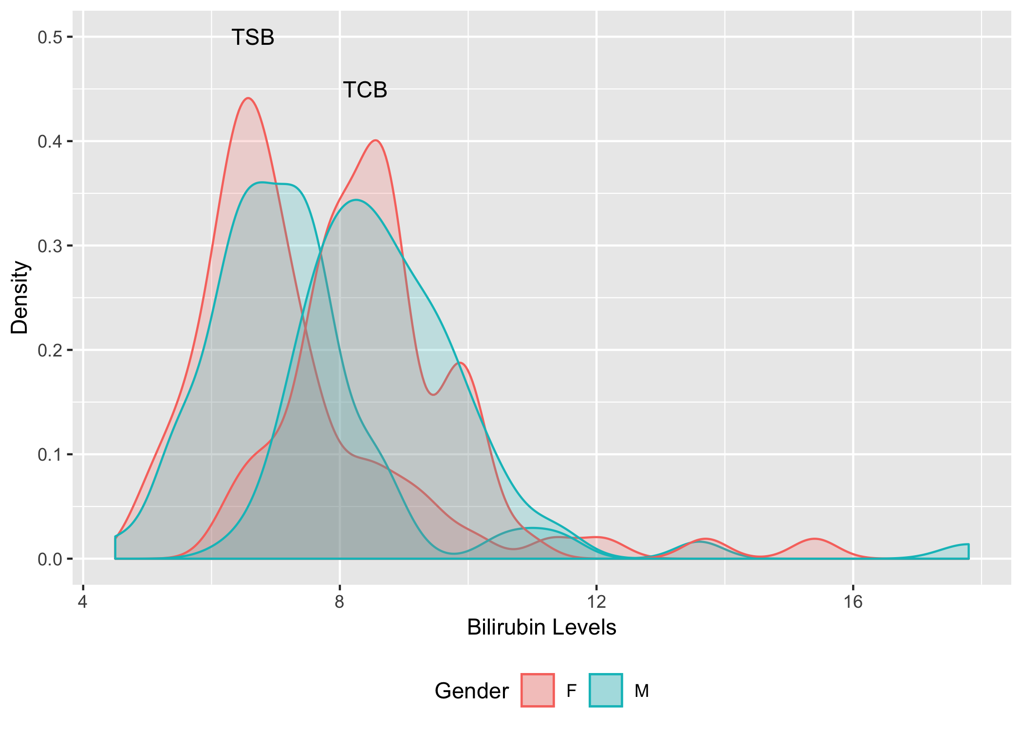
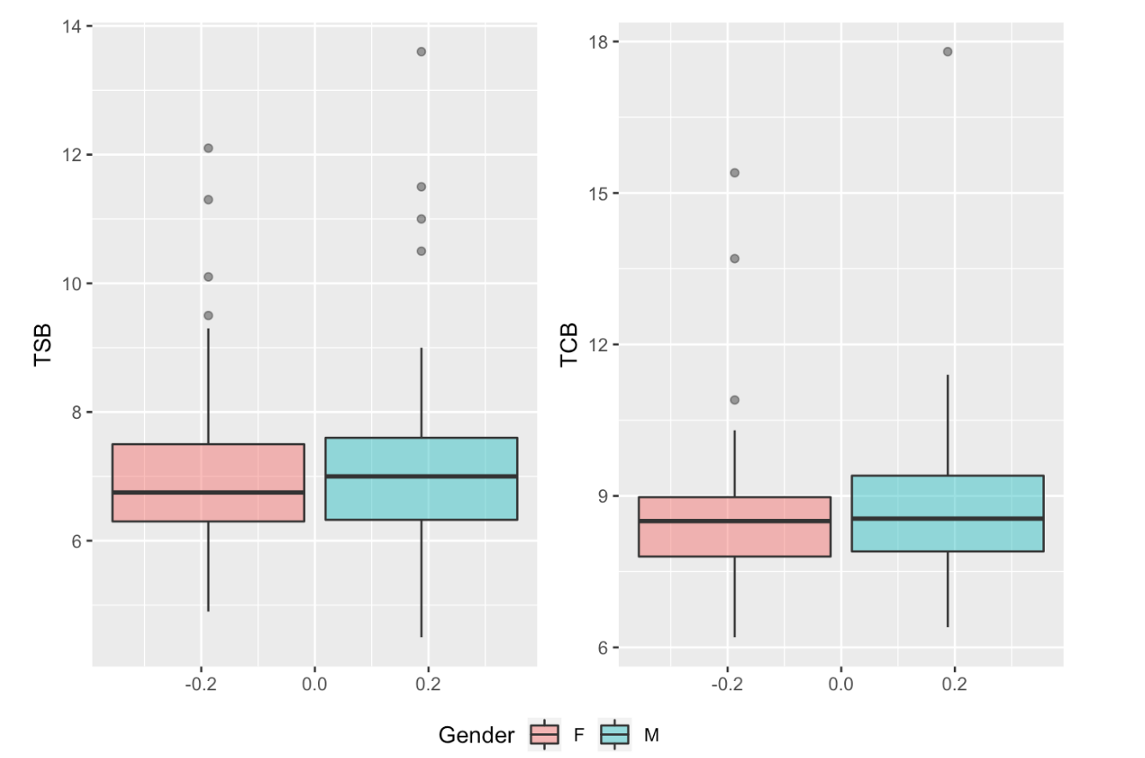
Visualizing TSB & TCB

Slide 9
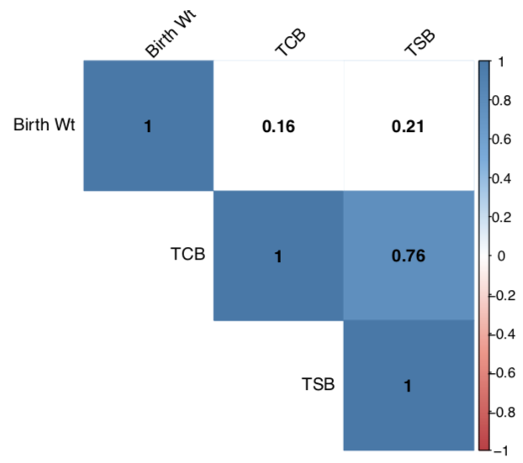
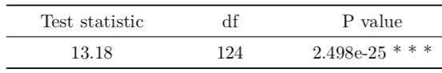
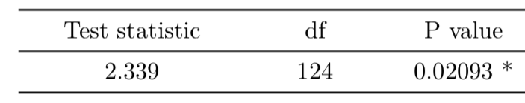
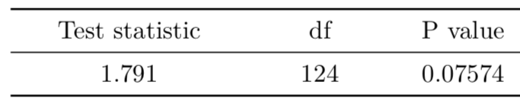
Correlation
TSB & TCB
TSB & Birth Weight
TCB & Birth Weight

Slide 10
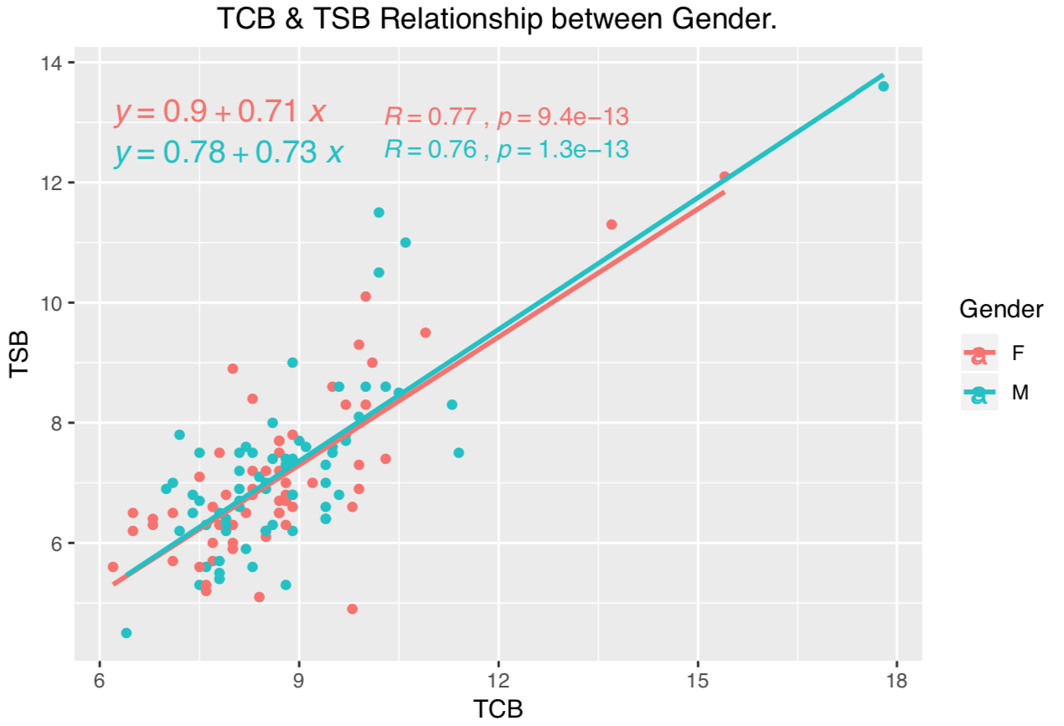
Linear Model Plot : TSB ~ TCB + Gender

Slide 11
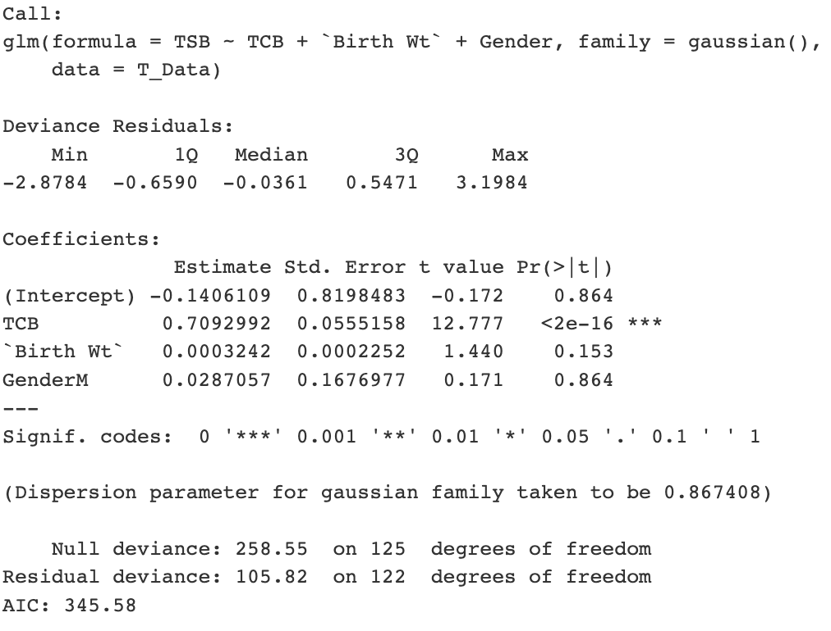
Model 1: TSB ~ TCB + Birth Wt + Gender
Significant
Insignificant
Insignificant

Slide 12
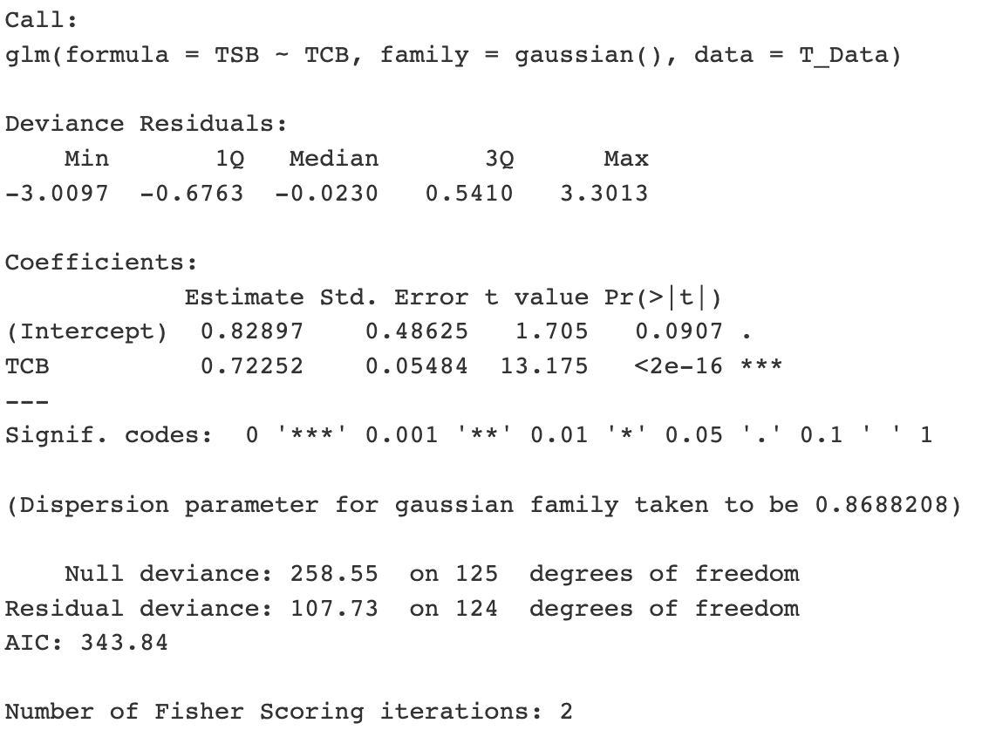
Model 2: TSB ~ TCB
Significant

Slide 13
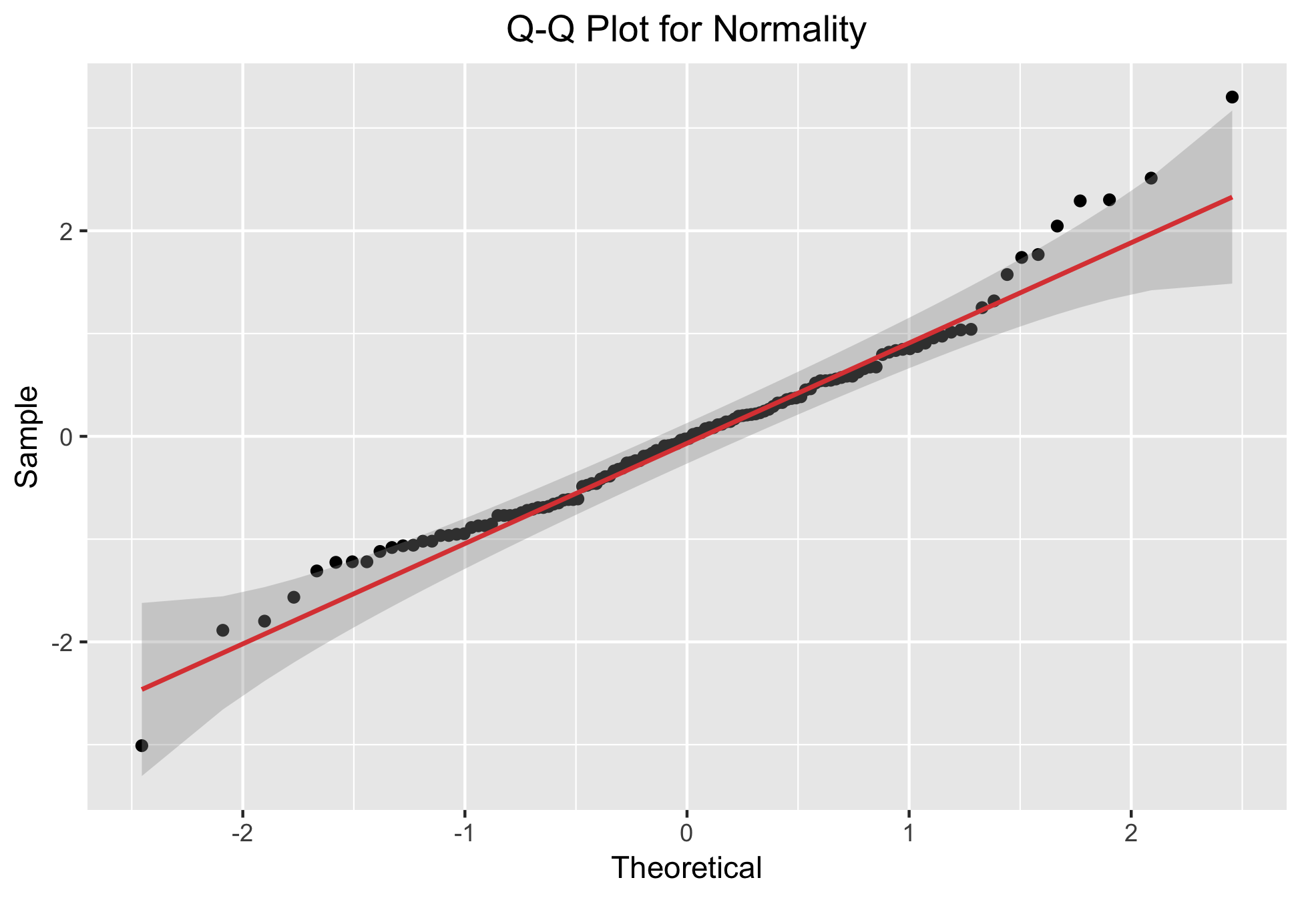
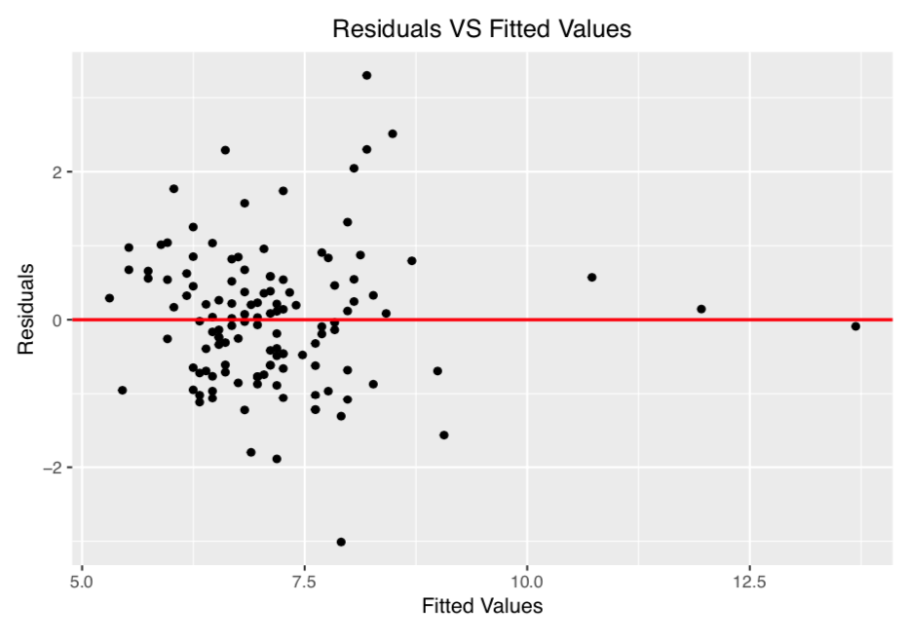
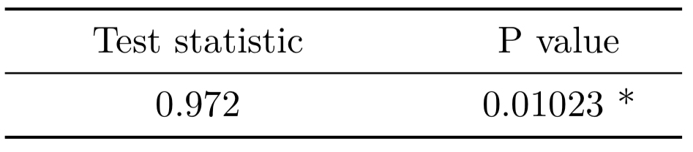
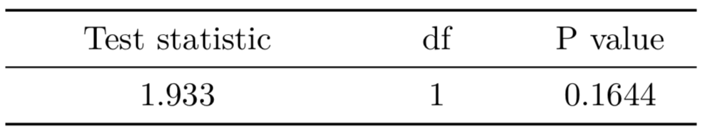
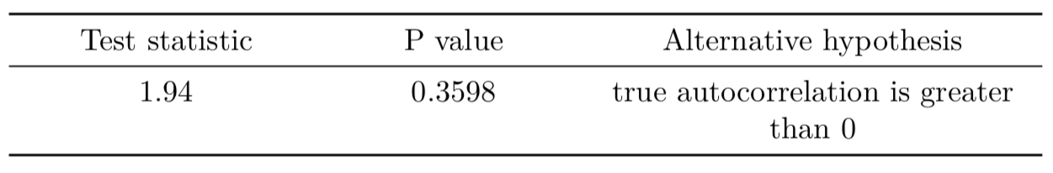
Model 2: Assumptions Check
Normality
Equal Variance
Violation
Independence

Slide 14
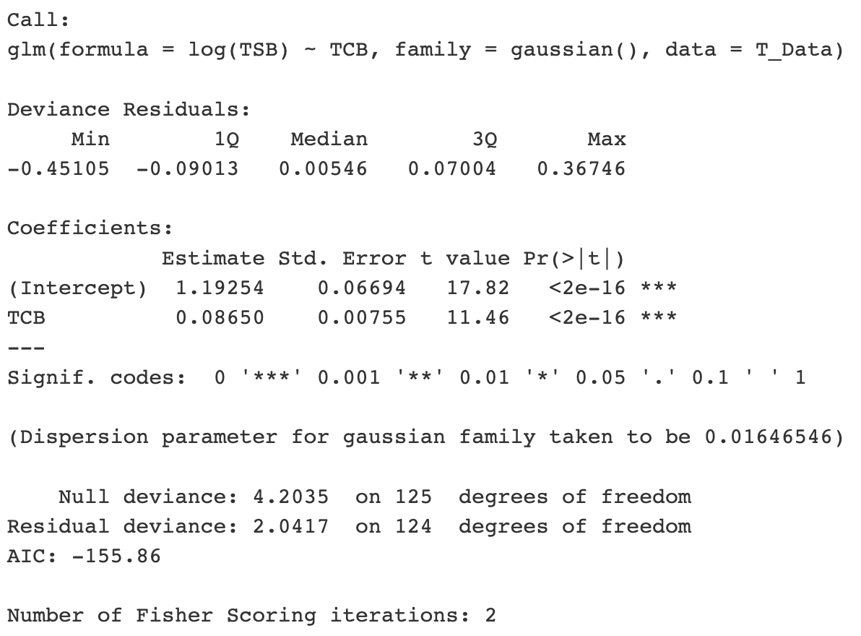
Model 3: log(TSB) ~ TCB
Significant

Slide 15
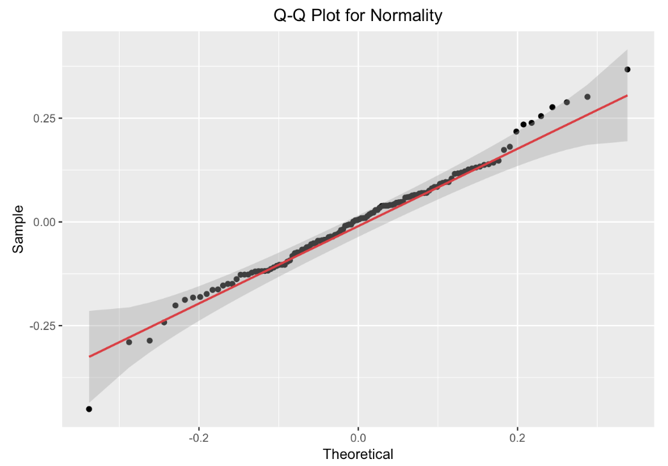
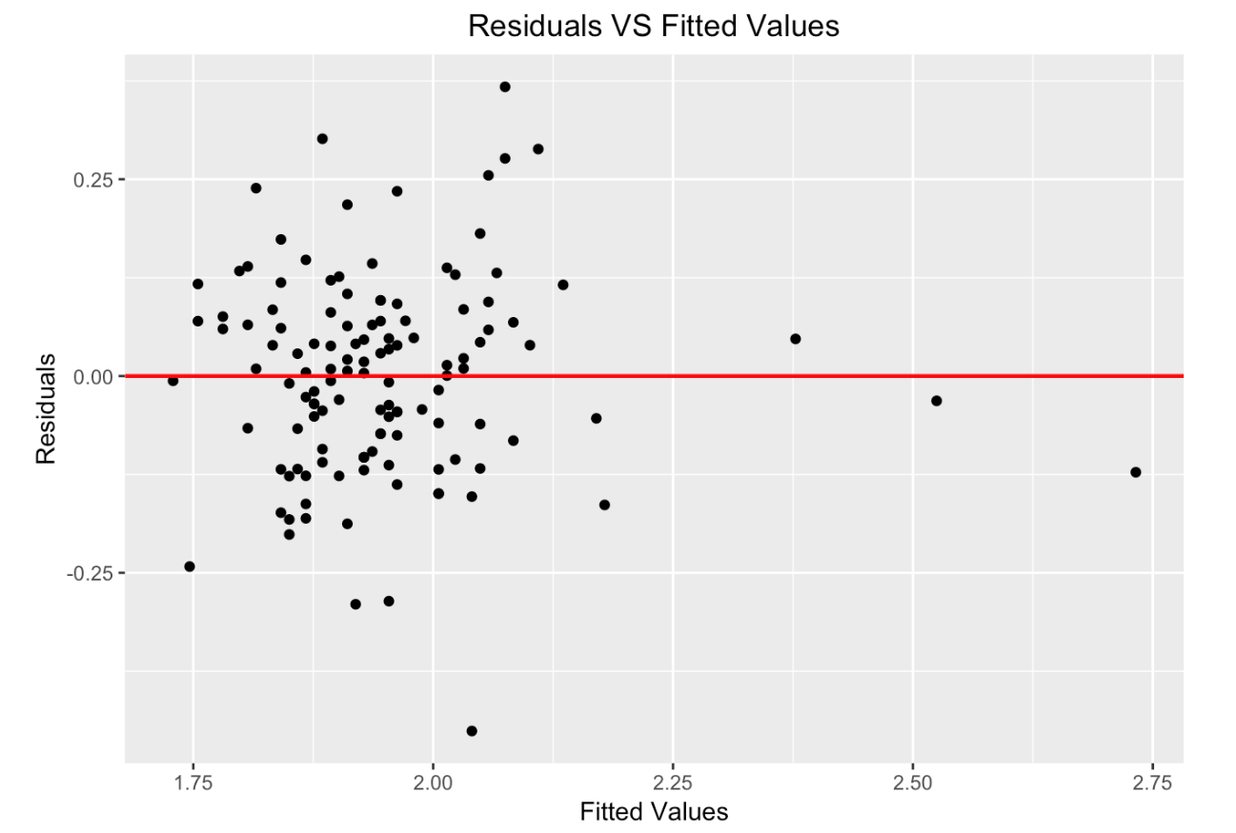
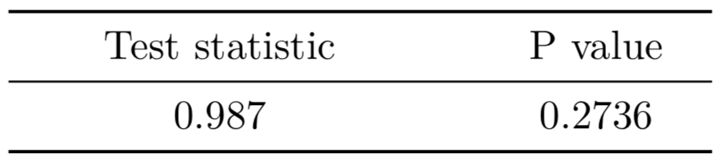
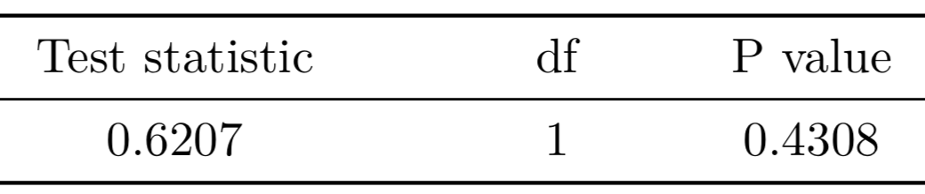
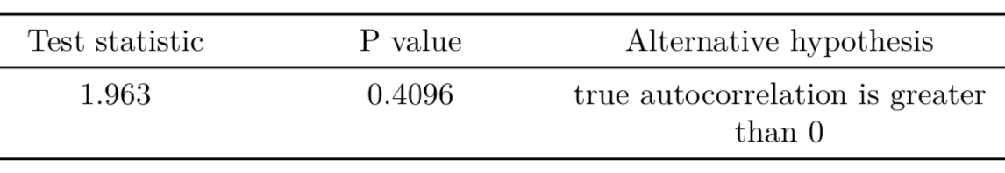
Model 3: Assumptions Check
Normality
Equal Variance
Independence

Slide 16
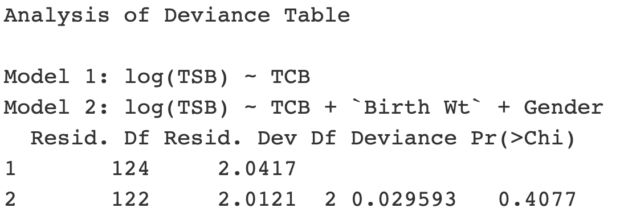
10 Fold Cross Validation
Model 2: TSB ~ TCB
Delta: 0.8774399 0.8762413
Model 3: log(TSB) ~ TCB
Delta: 0.01674727 0.01671932
Insignificant
Thus the reduced model performs better than than the full model.

Slide 17
Conclusion
TSB & TCB have a strong positive linear relationship with r = 0.76
The best performing model is log(TSB) ~ TCB .
 | AIC | C.V Delta
TSB ~ TCB | 343.84 | 0.8762
log(TSB) ~ TCB | -115.86 | 0.0167

